Slide 1
EECS 498 System Design of a Search Engine
Winter 2026
Lab 3: Basics of Developer Workflow/Productivity
GSI: Christopher Davis
IA: Rickey Dong
Nicole Hamilton
https://web.eecs.umich.edu/~nham/
nham@umich.edu

Slide 2
agenda
Announcements
Upcoming assignments
Debugging in VSCode
Shared Codebase Patterns

Slide 3
agenda
Announcements
Upcoming assignments
Debugging in VSCode
Shared Codebase Patterns

Slide 4
Office Hours
Chris:
Tues/Thurs 12:00-3:00 (1010 DOW)
By appointment (virtually) most other times M-F.
Just email chcdavis@umich.edu with EECS498W26 in title.
Rickey:
Mon 3:30-4:30 (1637 BBB Table #1)
Wed 2:30-4:00 (1270A Leinweber)

Slide 5
Reminders
String/Vector and UTF-8 autograder assignments due 1/25, this Sunday

Slide 6
Reminders
String/Vector and UTF-8 autograder assignments due 1/25, this Sunday
Group picture also due 1/25
  Tip: put some effort into this…

Slide 7
Announcements
Animal mascot voting finished!
We will have a cartoon design version of it, and hopefully print a t-shirt
If you have any ideas for the design, let us know!

Slide 8
agenda
Announcements
Upcoming assignments
Debugging in VSCode
Shared Codebase Patterns

Slide 9
Upcoming Assignments
HTML Parser: 2/1
HashTable: 2/1
Project Plan: 2/1

Slide 10
New Assignments
HTML Parser: 2/1
HashTable: 2/1
Project Plan: 2/1
HashBlob/HashFile: 2/8
Multithreaded File I/O: 2/8

Slide 11
New Assignments
HTML Parser: 2/1
HashTable: 2/1
Project Plan: 2/1
HashBlob/HashFile: 2/8
Multithreaded File I/O: 2/8
Linux GetURL: 2/15

Slide 12
New Assignments
HTML Parser: 2/1
HashTable: 2/1
Project Plan: 2/1
HashBlob/HashFile: 2/8
Multithreaded File I/O: 2/8
Linux GetURL: 2/15
Linux GetSSL: 2/22
Linux TinyServer: 2/22

Slide 13
New Assignments
HTML Parser: 2/1
HashTable: 2/1
Project Plan: 2/1
HashBlob/HashFile: 2/8
Multithreaded File I/O: 2/8
Linux GetURL: 2/15
Linux GetSSL: 2/22
Linux TinyServer: 2/22
Midterm: 2/26

Slide 14
New Assignments (Tips)
You’ll have to start working on them alongside your project!
  Plan things out; split work, do them concurrently
  Even if you don’t do some of the assignment, you should still have an understanding of how it works!

Slide 15
New Assignments (Tips)
You’ll have to start working on them alongside your project!
  Plan things out; split work, do them concurrently
  Even if you don’t do some of the assignment, you should still have an understanding of how it works!
Speaking of planning things out and working together, I’ll cover some of that in a later section

Slide 16
agenda
Announcements
Upcoming assignments
Debugging in VSCode
Shared Codebase Patterns

Slide 17
Debugging

Slide 18
agenda
Announcements
Upcoming assignments
Debugging in VSCode
Shared Codebase Patterns

Slide 19
Foreword
I’m about to dump out a bunch of stuff
For brevity, can’t go in-depth into all of it
But, I will post resources covering all of this to EdStem
  (And at the end for Canvas)
Feel free to talk or email me if you have any questions, or otherwise want a discussion

Slide 20
Version Control Systems (VCS)
You need to be using a VCS…
  Organizes your work
  Makes collaboration easier
  Safeguards against AI/cheating if you have reasonable commits
A couple options: Git, Mercurial, etc.
  Just use Git
  Hopefully you’ve used it for an EECS course already
  Even if you have, there’s still a lot to learn; especially for collaborative projects

Slide 21
Git Refresher
Edit my_work.cpp
git add my_work.cpp
git commit -m “This is a commit message”
git push [remote] [branch]

Slide 22
Git Refresher
Edit my_work.cpp
git add my_work.cpp
git commit -m “This is a commit message”
git push [remote] [branch]
Can use the CLI, or a GUI like Github Desktop

Slide 23
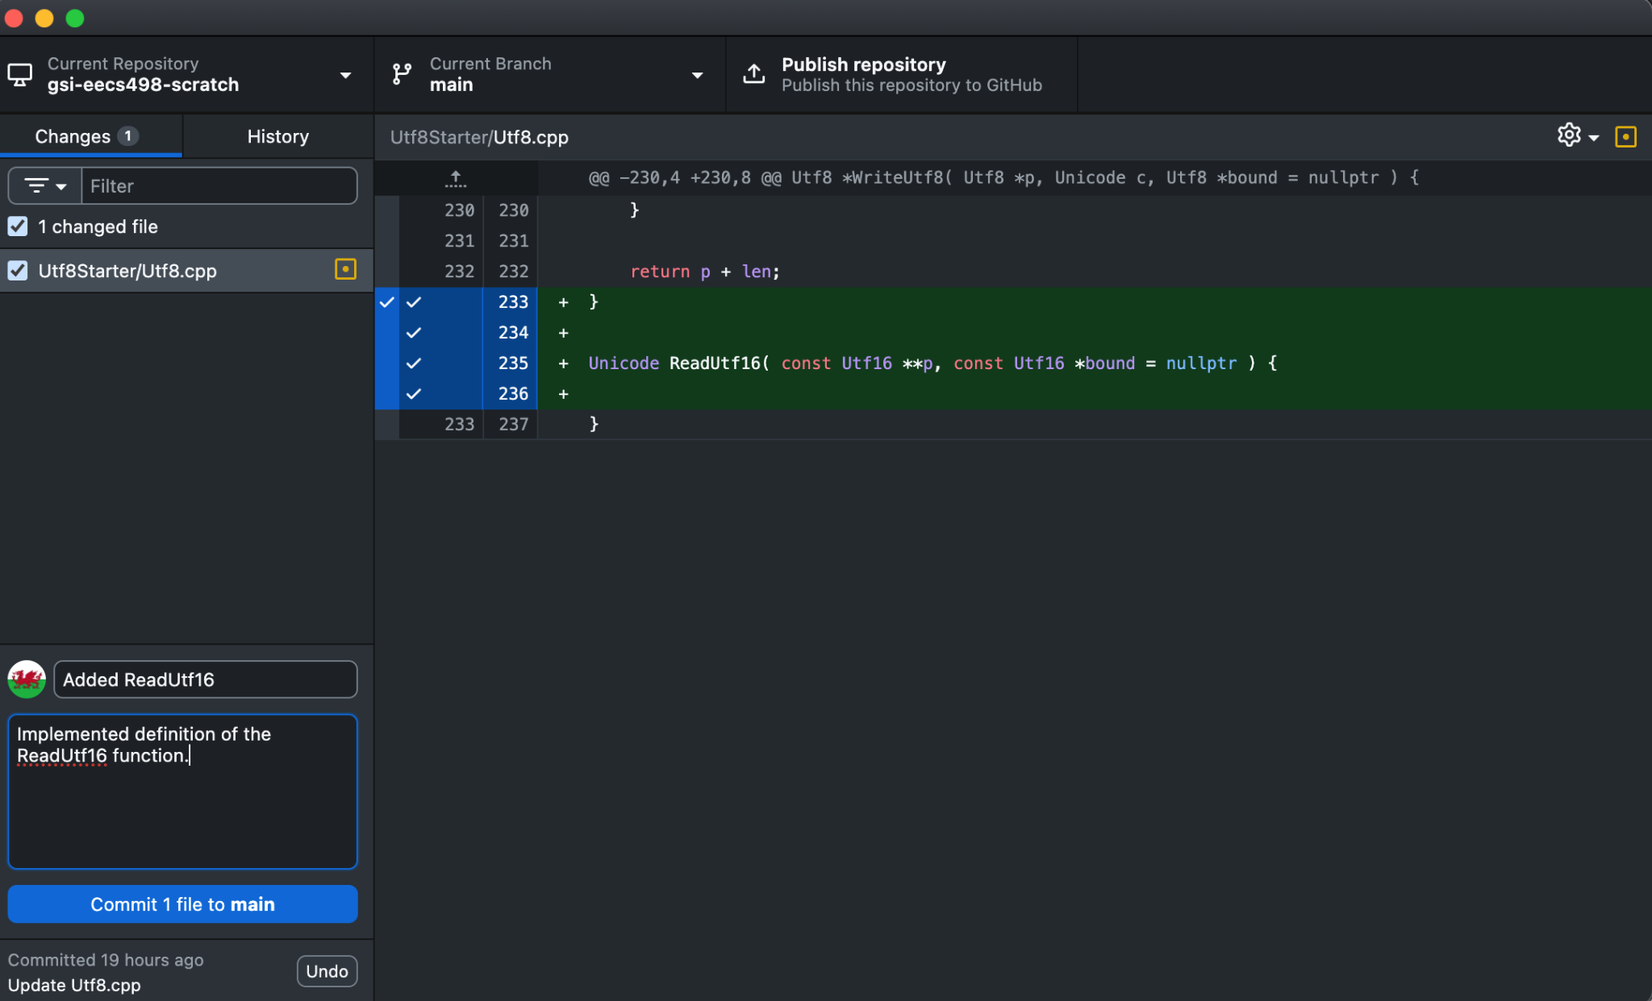
Git Refresher

Slide 24
Collaboration
This is easy for solo projects, but what about collaboration?
Probably the first time many of you will work on a codebase of >2-3 people (or maybe even >1)
Effective collaboration is a well-thought out and debated problem
I will go over some common patterns
Opinionated, and you should do what you feel works best, but make sure it’s a conscious decision to maximize productivity

Slide 25
The Basics (Branching)
Instead of working off of main, use feature branches!
git checkout -b <new-branch-name>
git checkout <existing-branch>

Slide 26
The Basics (Branching)
Instead of working off of main, use feature branches!
git checkout -b <new-branch-name>
git checkout <existing-branch>
You can work safely in your own isolated workspace!
You don’t want to type in the same space as someone in a Google Doc – so don’t do it in code!

Slide 27
The Basics (Branching)
Instead of working off of main, use feature branches!
git checkout -b <new-branch-name>
git checkout <existing-branch>
You can work safely in your own isolated workspace!
You don’t want to type in the same space as someone in a Google Doc – so don’t do it in code!
Of course, this introduces other complexities…

Slide 28
Merges
If two people have different branches, then the code they’ve written could still conflict
What to do?

Slide 29
Merges and PRs
If two people have different branches, then the code they’ve written could still conflict
What to do?
  Try and avoid in the first place (more on this later)
  Pull Requests!

Slide 30
Merges and PRs
If two people have different branches, then the code they’ve written could still conflict
What to do?
  Try and avoid in the first place (more on this later)
  Pull Requests!
Why do pull requests?

Slide 31
Merges and PRs
If two people have different branches, then the code they’ve written could still conflict
What to do?
  Try and avoid in the first place (more on this later)
  Pull Requests! (aka PRs or CLs)
Why do pull requests?
  Have someone else review your code…

Slide 32
Merges and PRs
If two people have different branches, then the code they’ve written could still conflict
What to do?
  Try and avoid in the first place (more on this later)
  Pull Requests! (aka PRs or CLs)
Why do pull requests?
  Have someone else review your code…
  Protect the release version
    Don’t want to have someone break a bunch of stuff in “prod”, then have to try and cherry-pick rollbacks…

Slide 33

Merges and PRs
PRs should be atomic

Slide 34
Merges and PRs
PRs should be atomic, and cover only what’s required for the feature.
I.e., only change one module at a time
Your bug fixes to the crawler shouldn’t be include in a PR to add a new map structure
Why?

Slide 35
Merges and PRs
PRs should be atomic, and cover only what’s required for the feature.
I.e., only change one module at a time
Your bug fixes to the crawler shouldn’t be include in a PR to add a new map structure
Why?
  Easier to roll-back or cherry pick discrete, atomic changes
  Smaller, discrete changes much easier to review

Slide 36
Merges and PRs
PRs should be atomic, and cover only what’s required for the feature.
I.e., only change one module at a time
Your bug fixes to the crawler shouldn’t be include in a PR to add a new map structure
Why?
  Easier to roll-back or cherry pick discrete, atomic changes
  Smaller, discrete changes much easier to review
Ideally, your PRs are also working and pass testing, but with greenfield projects it’s a bit different, since there’s so much setup, as opposed to incremental features or bug fixes.

Slide 37
Collaboration
Decide on a coding standard/style
  Can be automated! (More on this later)

Slide 38
Collaboration
Decide on a coding standard/style
  Can be automated! (More on this later)
Review each others code!
  Can require x number of reviewers to merge into main

Slide 39
Collaboration
Decide on a coding standard/style
  Can be automated! (More on this later)
Review each others code!
  Can require x number of reviewers to merge into main
Most importantly…

Slide 40
Collaboration
Decide on a coding standard/style
  Can be automated! (More on this later)
Review each others code!
  Can require x number of reviewers to merge into main
Most importantly…
  Split work up publically and fairly
    Sucks to do duplicate work
  Track urgency and progress
    Also sucks to be blocked

Slide 41
Collaboration
Decide on a coding standard/style
  Can be automated! (More on this later)
Review each others code!
  Can require x number of reviewers to merge into main
Most importantly…
  Split work up publically and fairly
    Sucks to do duplicate work
  Track urgency and progress
    Also sucks to be blocked
  Many different “ticket” systems to do this
    I’ll share one of my favorites

Slide 42
Collaboration (Github)
Need to host code somewhere everyone can access
  Many options: Github, Gitlab, etc.
  Github has a LOT of other QOL dev features…
    Actions, Github Desktop, Issues, Projects, Orgs
  So, I recommend Github
    I’ll talk through some of these features as we get to the relevant section

Slide 43
Collaboration (Github)
Need to host code somewhere everyone can access
  Many options: Github, Gitlab, etc.
  Github has a LOT of other QOL dev features…
    Actions, Github Desktop, Issues, Projects, Orgs
  So, I recommend Github
    I’ll talk through some of these features as we get to the relevant section
      First, Github Issues and Organizations

Slide 44
Github
Create an organization for your team
  Allows you to group multiple repos together
Can also make projects, which allow you to track and assign issues for repos
  Github issues / projects are very feature rich, can do quite a lot with them
Make your issues detailed
  Are they a bug? Feature request?
  How urgent is it? How large is it?
  Who is assigned to it?
  What do we need to deliver?

Slide 45
Github
DEMO

Slide 46
Repository Patterns
How should we organize our codebases?

Slide 47
Repository Patterns
How should we organize our codebases?
Monorepo
  Everything all in one repo
  Why?

Slide 48
Repository Patterns
How should we organize our codebases?
Monorepo
  Everything all in one repo
  Why?
    Makes dependency management easier
    But can have more merge conflicts
  This is what Google does

Slide 49
Repository Patterns
How should we organize our codebases?
Monorepo
  Everything all in one repo
  Why?
    Makes dependency management easier
    But can have more merge conflicts
    This is what Google does
Git submodules / “microservices”
  Different repo for different components
  Why?

Slide 50
Repository Patterns
How should we organize our codebases?
Monorepo
  Everything all in one repo
  Why?
    Makes dependency management easier
    But can have more merge conflicts
    This is what Google does
Git submodules / “microservices”
  Different repo for different components
  Why?
    Less merge conflicts
    But, submodule updates are trickier
  This is what Amazon / AWS does

Slide 51
Build Systems
I’m sure many of you had just been hand-compiling with gcc/clang in the terminal. Or maybe you even had a Makefile.
But now…

Slide 52
Build Systems
I’m sure many of you had just been hand-compiling with gcc/clang in the terminal. Or maybe you even had a Makefile.
But now…
Lots of different people on your team
  Different OS, different hardware, (maybe) different compilers
  Meeting all of these targets with scripts or Makefiles is tricky
  Also doesn’t have a nice way of dealing with huge nested projects and repos

Slide 53
Build Systems
I’m sure many of you had just been hand-compiling with gcc/clang in the terminal. Or maybe you even had a Makefile.
But now…
Lots of different people on your team
  Different OS, different hardware, (maybe) different compilers
  Meeting all of these targets with scripts or Makefiles is tricky
  Also doesn’t have a nice way of dealing with huge nested projects and repos
  Build systems can help this

Slide 54
Build Systems
Think of them as an abstraction above Makefiles.
They transparently support multiple OSes and compilers.
They also intuitively support projects with large directory structures.

Slide 55
Build Systems
Think of them as an abstraction above Makefiles.
They transparently support multiple OSes and compilers.
They also intuitively support projects with large directory structures.
Unfortunately, C++ does not have a canonical build system, unlike, e.g., Cargo for Rust

Slide 56
Build Systems
Think of them as an abstraction above Makefiles.
They transparently support multiple OSes and compilers.
They also intuitively support projects with large directory structures.
Unfortunately, C++ does not have a canonical build system, unlike, e.g., Cargo for Rust
Many different options.
Bazel (Google’s)
CMake (industry standard)
Meson, Premake, VS, etc.

Slide 57
Build Systems
Many different options.
Bazel (Google’s)
CMake (industry standard)
Meson, Premake, VS, etc.
I recommend CMake or Bazel, as they will have the most documentation, and I can help. Also, good VSCode support.
Unfortunately (especially for CMake), they can be pretty old, esoteric, and uncomfortable. But, with some practice (and references), make development A LOT easier.

Slide 58
Build Systems (Example)
I will release a build system lab assignment on Canvas next week
  Can do in either Bazel or CMake
  Make a toy repo build

Slide 59
Build Systems (Example)
I will release a build system lab assignment on Canvas next week
  Can do in either Bazel or CMake
  Make a toy repo build
But let’s give a quick example so you can see the benefits.

Slide 60
Build Systems (Example: Library)
I will give an example Library project structure

Slide 61
Unit Testing
Very important (at least for your library methods)

Slide 62
Unit Testing
Very important (at least for your library methods)
Unfortunately, EECS does not prepare you much for the real world…

Slide 63
Unit Testing
Very important (at least for your library methods)
Unfortunately, EECS does not prepare you much for the real world…
  280/281/etc. use custom scripts or raw CTest
  In industry, almost everyone uses Google Test

Slide 64
Unit Testing (Google Test)
Open source unit testing framework from Google
TEST(TestSuiteName, TestName) {
EXPECT_EQ(foo(), true);
EXPECT_GE(2, 1);
}

Slide 65
Unit Testing (Google Test)
Open source unit testing framework from Google
TEST(AlgorithmTests, Max) {
int i1 = 1, i2 = 2;
EXPECT_EQ(core::max(i1, i2), i2);
EXPECT_EQ(core::max(-1,-2),-1);
EXPECT_EQ(core::max(i1, i2, std::greater{}), i1);
EXPECT_EQ(core::max(1,2, std::greater{}), 1);
EXPECT_EQ(core::max({1,2,3,4}), 4);
EXPECT_EQ(core::max({1,2,3,4}, std::greater{}), 1);
}

Slide 66
Unit Testing (Google Test)
It’s also natively supported by CMake (and CTest)!
Can make the dev workflow pretty nice. Personally, I like GUIs. I’ll show you what my setup is.

Slide 67
Unit Testing (Google Test)
DEMO

Slide 68
Microbenchmarks
What is a microbenchmark? Why do it?

Slide 69
Microbenchmarks
What is a microbenchmark? Why do it?
  Benchmark performance of small sample of code
  Like Unit Tests, but for performance
  Performance is unintuitive – why?

Slide 70
Microbenchmarks
What is a microbenchmark? Why do it?
  Benchmark performance of small sample of code
  Like Unit Tests, but for performance
  Performance is unintuitive – why?
For our search engines, what might we want to test?

Slide 71
Microbenchmarks
What is a microbenchmark? Why do it?
  Benchmark performance of small sample of code
  Like Unit Tests, but for performance
  Performance is unintuitive – why?
For our search engines, what might we want to test?
  Posting list decompression, HTML parsing, etc.

Slide 72
Microbenchmarks
What is a microbenchmark? Why do it?
  Benchmark performance of small sample of code
  Like Unit Tests, but for performance
  Performance is unintuitive – why?
For our search engines, what might we want to test?
  Posting list decompression, HTML parsing, etc.
Industry standard framework is Google Benchmark

Slide 73
Microbenchmarks
What is a microbenchmark? Why do it?
  Benchmark performance of small sample of code
  Like Unit Tests, but for performance
  Performance is unintuitive – why?
For our search engines, what might we want to test?
  Posting list decompression, HTML parsing, etc.
Industry standard framework is Google Benchmark
More on this in later labs (when we get lower level)…

Slide 74
Miscellaneous
Will have lots of dev artifacts
  Builds, .DS_Store, .vscode/, etc.
  You probably don’t want this in your VCS!!!
Luckily, can ignore it with a .gitignore file
  Just put in regex for files you want to ignore, and they won’t get tracked by git
  They work recursively, so you can have one in each component of your project
    E.g., foo/.gitignore, foo/bar/.gitignore

Slide 75
Miscellaneous (.gitignore)
build/*
.vscode/*
.DS_Store
*.dat
*.idx
Example .gitignore file

Slide 76
Miscellaneous (Formatting)
You can also automate formatting with .clang-format and .clang-tidy files!
  You can even require that someone passes them before merging…
  This way, you don’t need to worry about hand-perfecting all your tabs and whitespace – the script does it for you!
For example…
Can set indent and column width
Type name cases
  E.g., pascal case for enums, lower case for local variables

Slide 77
Miscellaneous (Analysis)
It also does some static analysis!
  What is static analysis?

Slide 78
Miscellaneous (Analysis)
It also does some static analysis!
  What is static analysis?
    Analyzes source code for bugs without running it
Speaking of analysis…
Address sanitizers -fsanitize=address
Memory analyzers (valgrind, etc.)

Slide 79
CI/CD (Github)
Github Actions: Github’s native CI/CD platform
Basically, allows scripts to run whenever you update main
Can run unit tests, integration tests, static analyzers, linters
Can rollback on failure, send alerts, etc.
“But it builds on my machine!”
Nice way of verifying cross-platform

Slide 80
Conclusion
Lots of information…
Don’t worry if this is overwhelming
Just a broad overview to expose you to some of these ideas / terms early
  Can’t really look up something you’ve never heard of
Will follow up in more detail in future labs / lab assignments
Again, feel free to come to OH, email me, or ask on EdStem with any questions

Slide 81
Addendum

Slide 82
References
Google Test: https://google.github.io/googletest/
The testing VSCode extension I use is C++ TestMate (matepek.vscode-catch2-test-adapter)
Very nice testing GUI
CMake (next lab will cover it more)
I use Microsoft’s CMake Tools VSCode extension.
Google Benchmark: https://github.com/google/benchmark

Slide 83
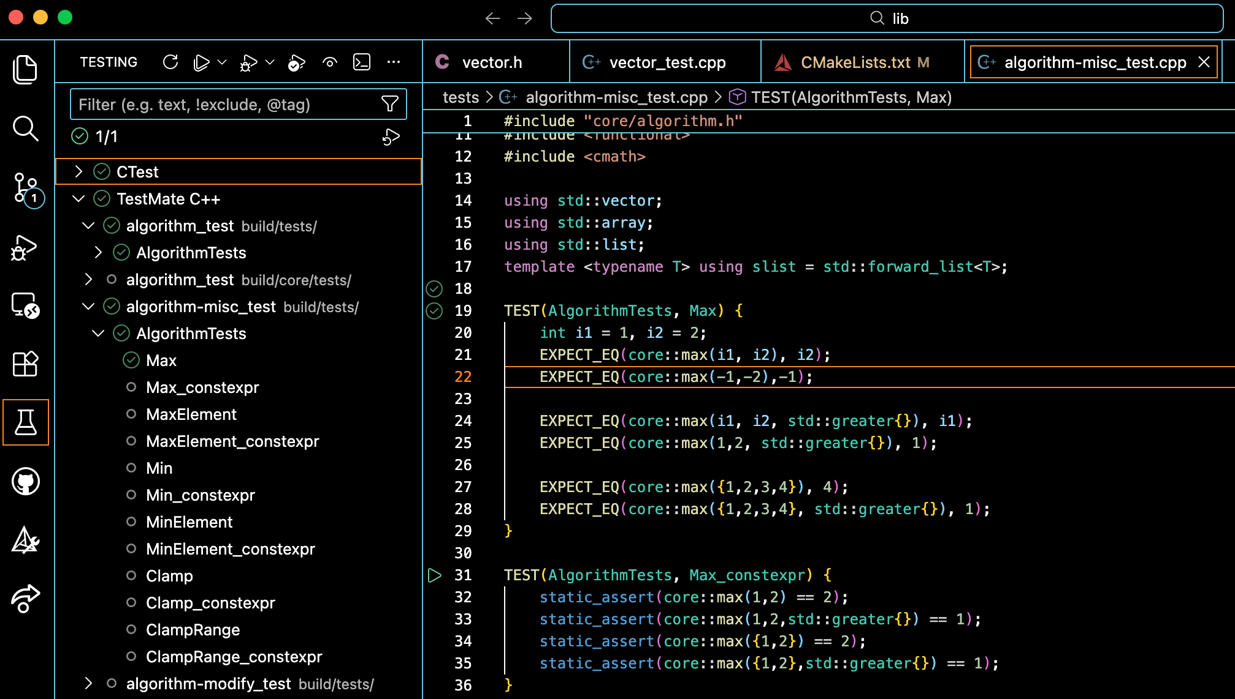
TestMate UI & Google Test Example

